Slide 1
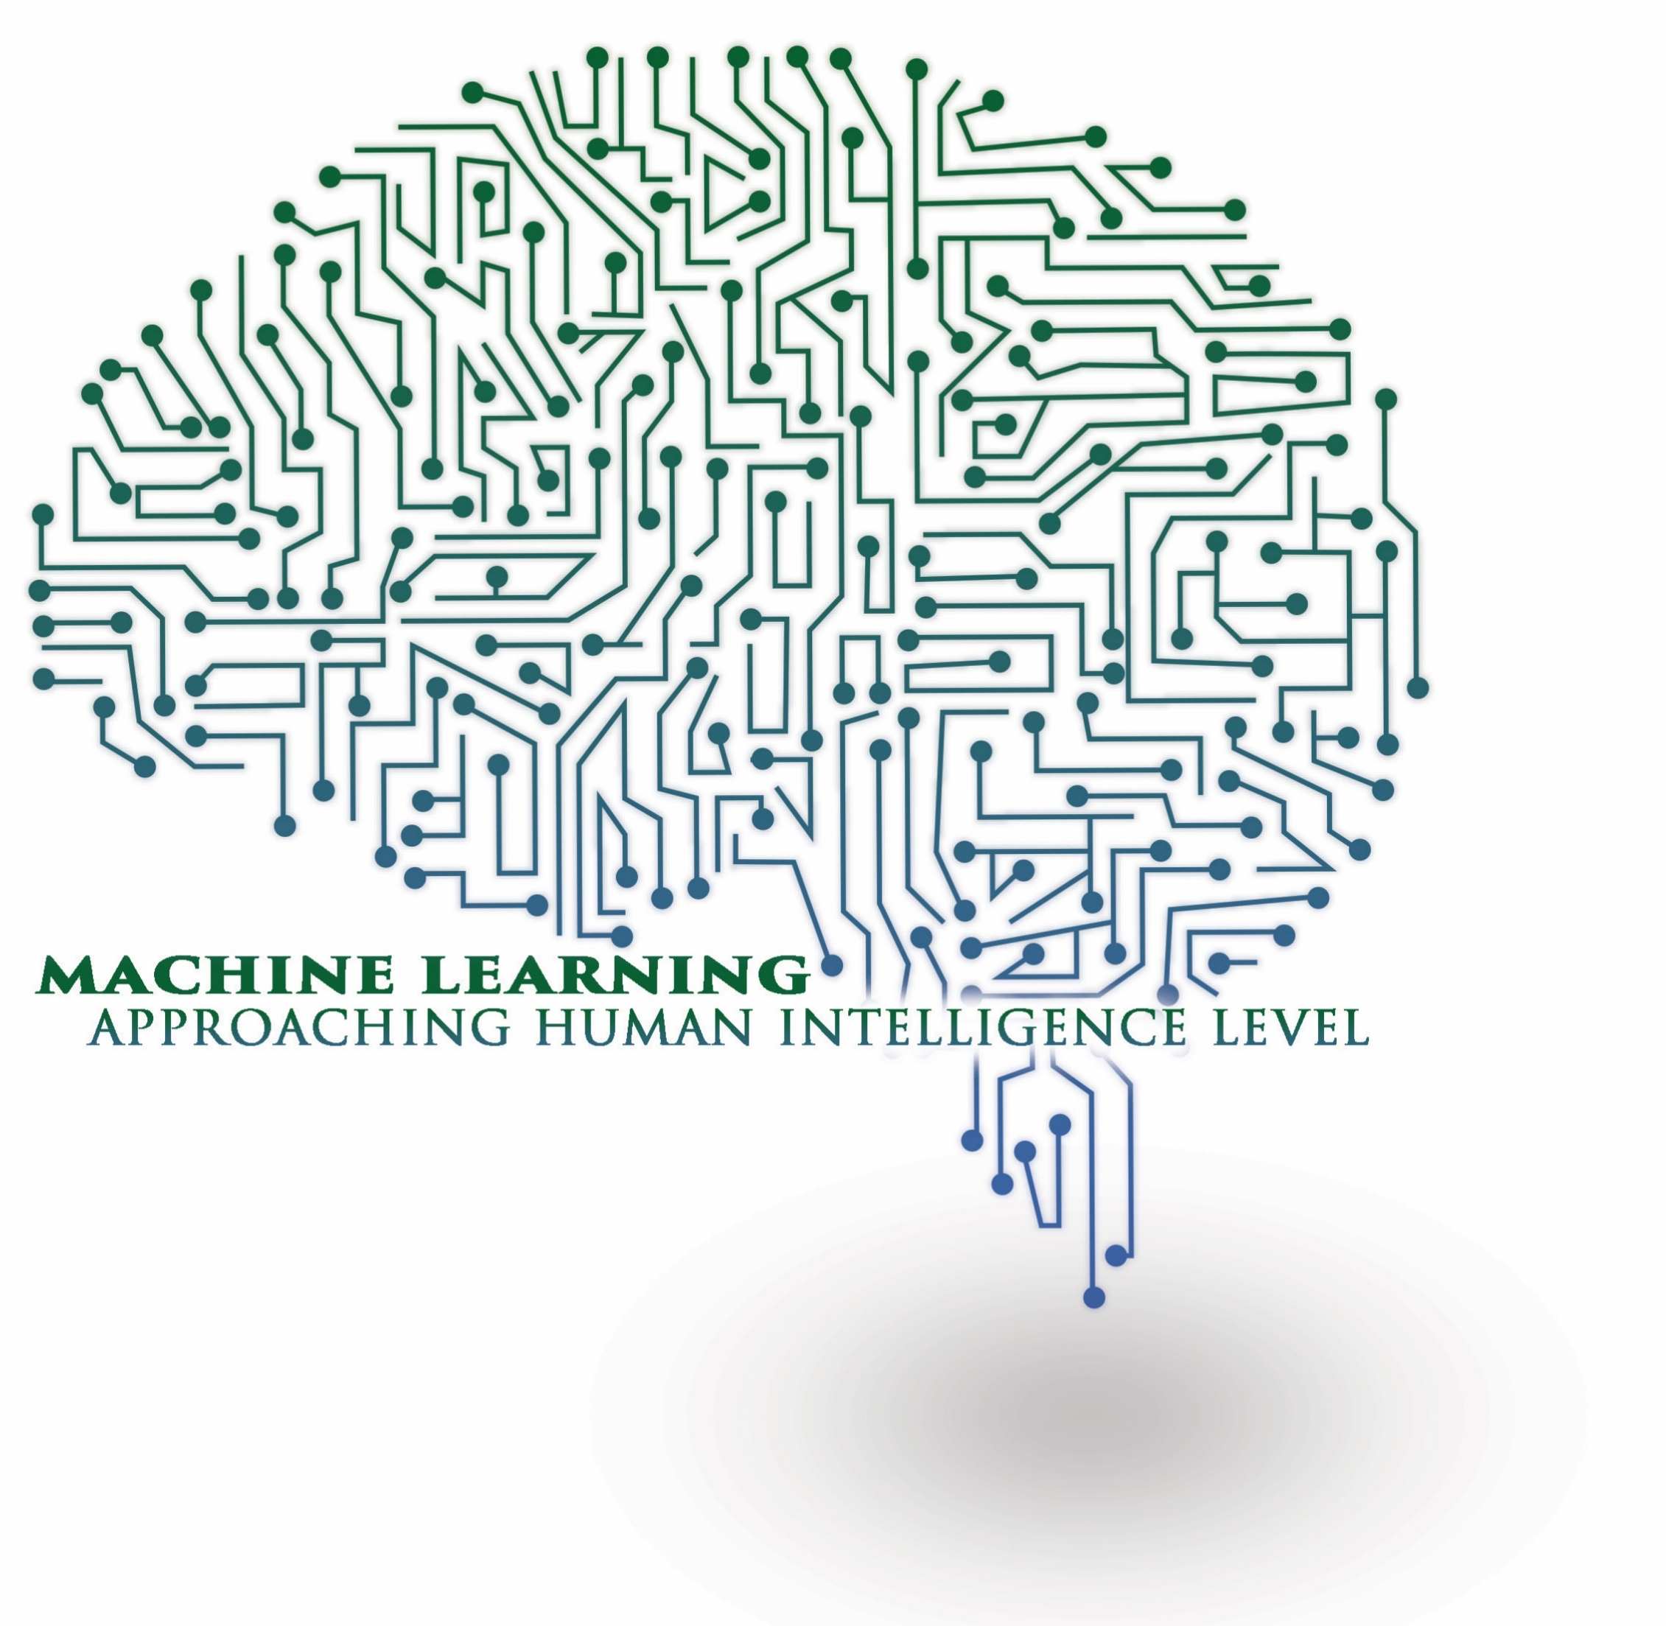
Machine learning
Introduction to ML and Linear Regression

Slide 2
The goals of AI is to create a machine which can mimic a human mind and to do that it needs learning capabilities, but also more; knowledge representation , logical reasoning and event thighs like abstract thinking.
Machine learning on the other hand focus on writing software or algorithms that can learn from past experience.

Slide 3
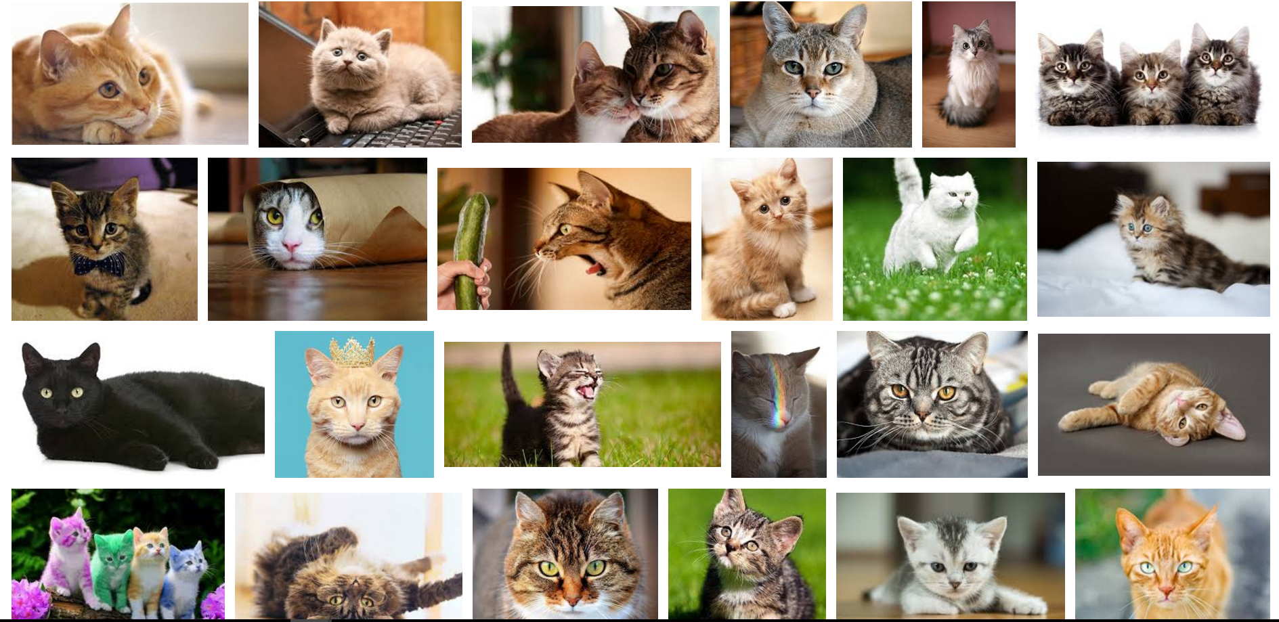

Arthur Samuel (1959). Machine Learning: Field of study that gives computers the ability to learn without being explicitly programmed.
Tom Mitchell (1998) definition “A computer program is said to learn from experience E with respect to some task T and some performance measure P, if its performance on T, as measured by P, improves with experience E”.
Notes:
Carnegie Mellon University

Slide 4
Outline
Introduction.
Machine learning paradigms.
Supervised learning
Unsupervised learning
Reinforcement learning
Linear regression.
Gradient decent.

Slide 5
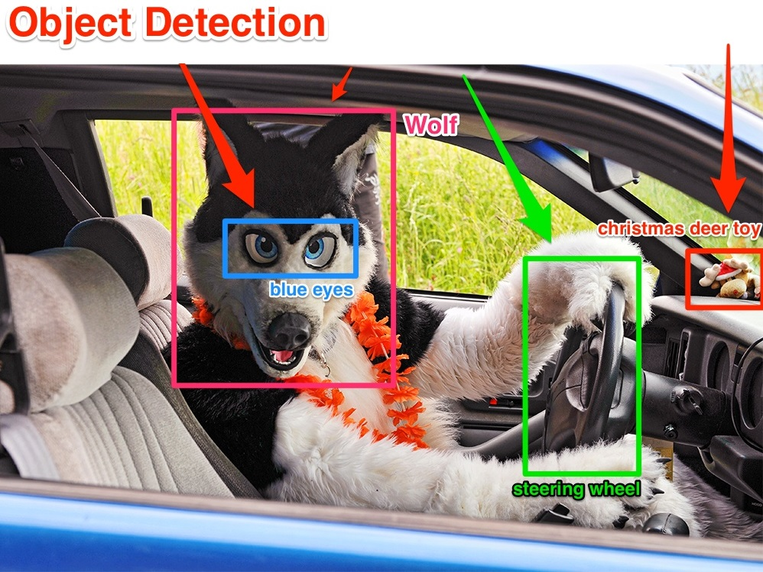


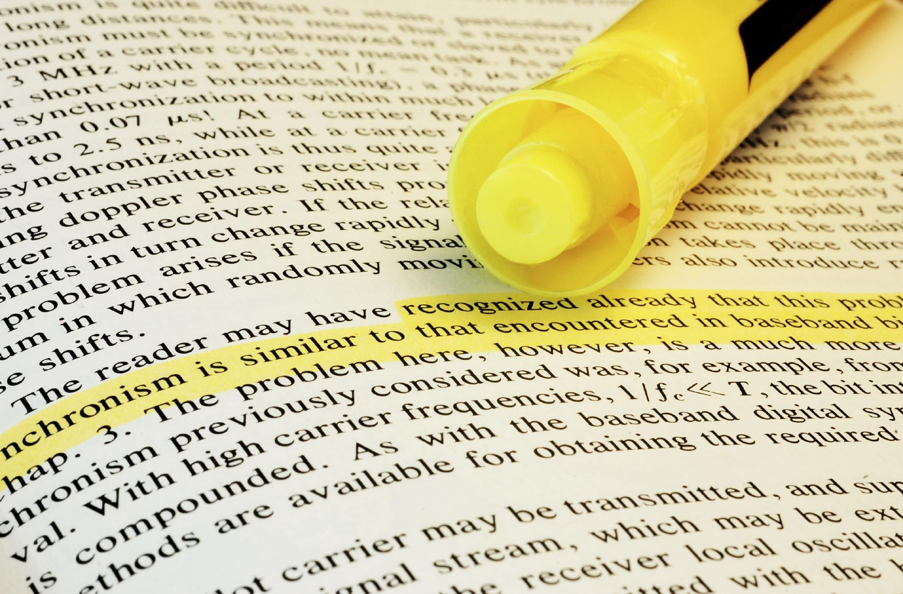
Applications of machine learning
Database mining
Text analysis
Speech Recognition

Slide 6
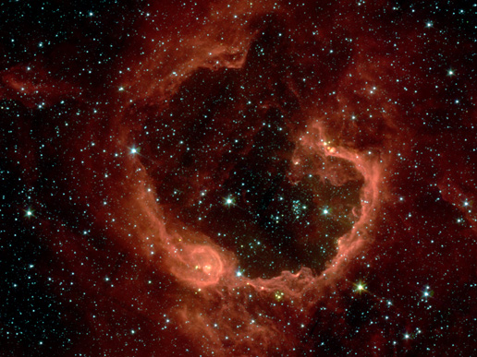


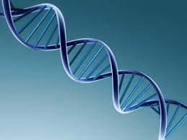
Image credit: NASA/JPL-Caltech/E. Churchwell (Univ. of Wisconsin, Madison)
Astronomical data analysis
Social network analysis
Market segmentation
Genome classification

Slide 7
Machine learning algorithms
Supervised learning
Unsupervised learning
Reinforcement learning

Slide 8
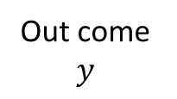
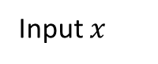
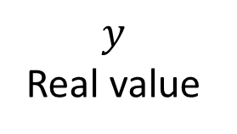
Supervised learning
Supervised learning is the machine learning task of inferring a function from labelled training data.
Predicting exam results
$$y$$
Real value
Out come $y$
exam results
hours
Input $x$

Slide 9
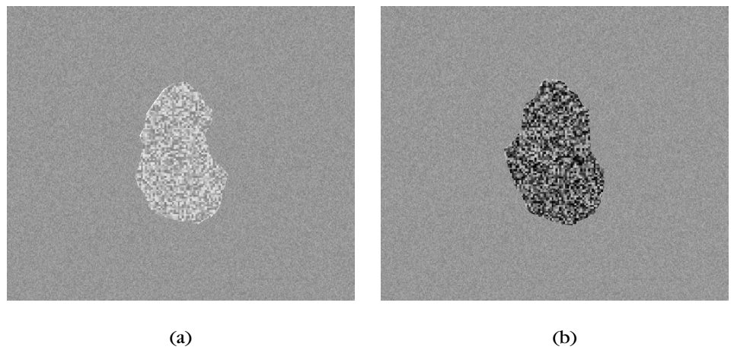
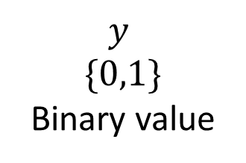
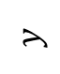
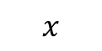
Class a
$$y$$
$$\{0,1\}$$
Binary value
$$y$$
Class b
$$x$$
size
thickness

Slide 10
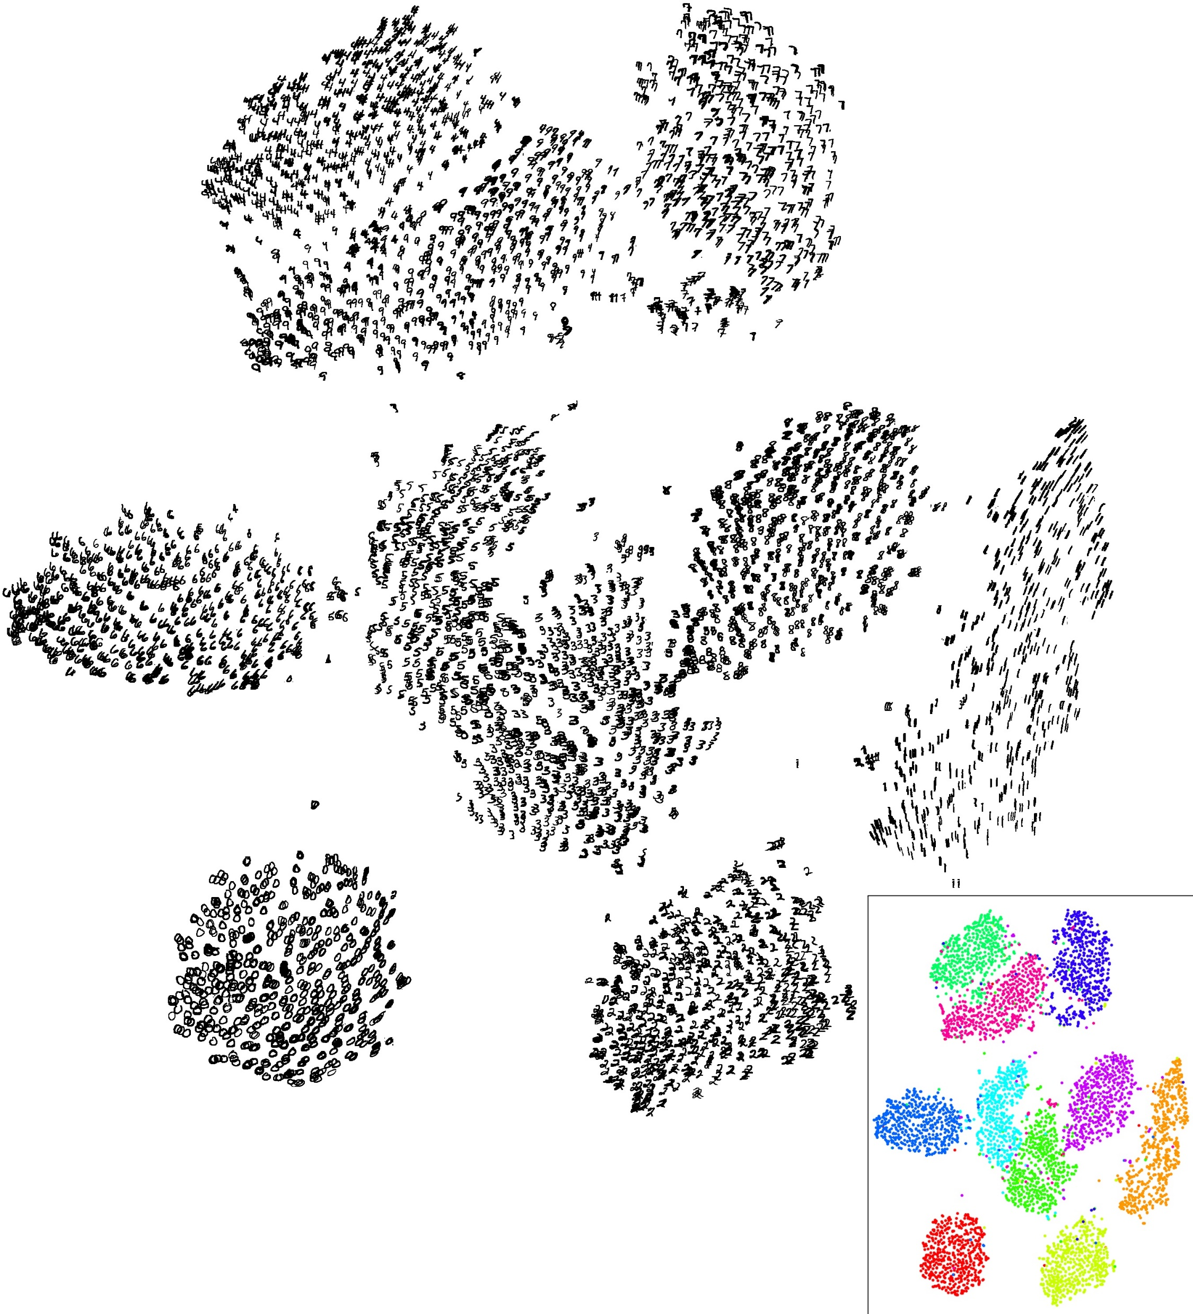
Unsupervised learning
Unsupervised learning is the machine learning task of inferring a function to describe hidden structure from "unlabelled" data.

Slide 11
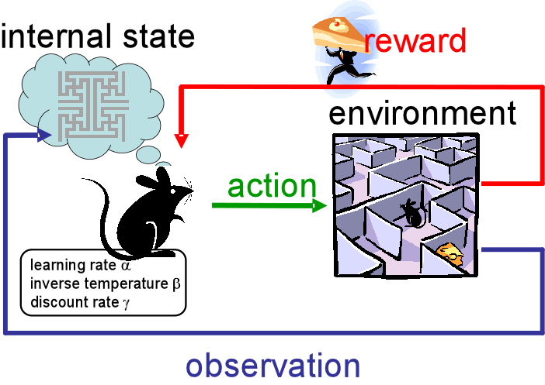
Reinforcement learning
Is an area of machine learning inspired by behaviourist psychology, concerned with how software agents ought to take actions in an environment so as to maximize some notion of cumulative reward.

Slide 12
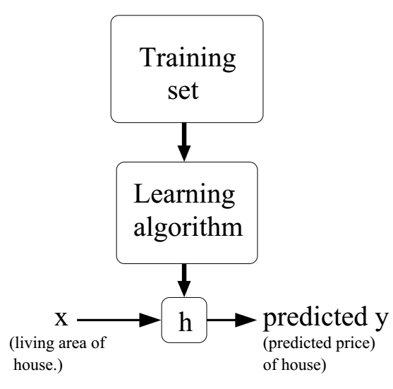

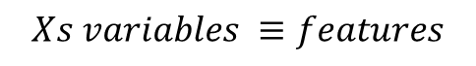
Machine learning basic terminology
$$Xs variables ≡features$$
$$θs ≡model prameter, the constant we are learning them$$
$$h_{θ}\left(x\right) model ≡hypothesis$$
$$Cost function J\left(θ\right)≡the evaluation criteria$$

Slide 13
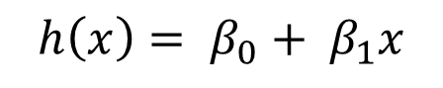
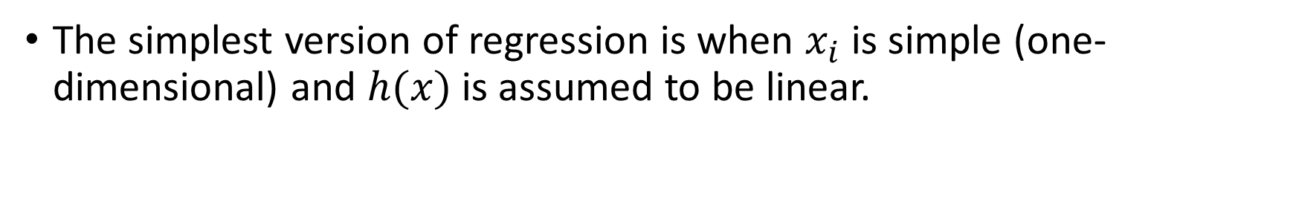
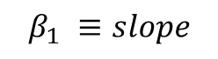
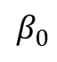
Linear Regression
The simplest version of regression is when $x_{i}$ is simple (one-dimensional) and $h(x)$is assumed to be linear.
$$h\left(x\right)= β_{0}+ β_{1}x$$
$$β_{1} ≡slope$$
$$β_{0}$$

Slide 14
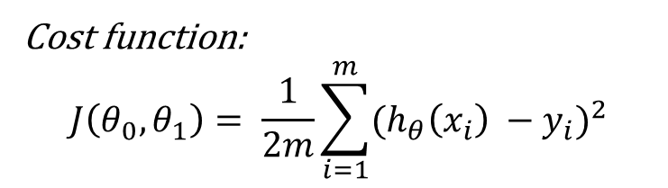
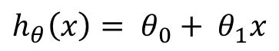
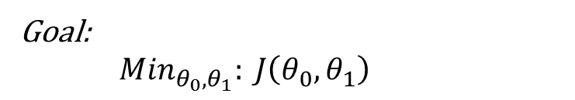
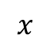
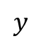
$$h_{θ}\left(x\right)= θ_{0}+ θ_{1}x$$
Cost function:
$$J\left(θ_{0},θ_{1}\right)= \frac{1}{2m}\sum_{i=1}^{m}{{(h_{θ}\left(x_{i}\right) −y_{i})}^{2}}$$
$$y$$
Goal:
${Min}_{θ_{0},θ_{1}}: J\left(θ_{0},θ_{1}\right)$
$$x$$

Slide 15
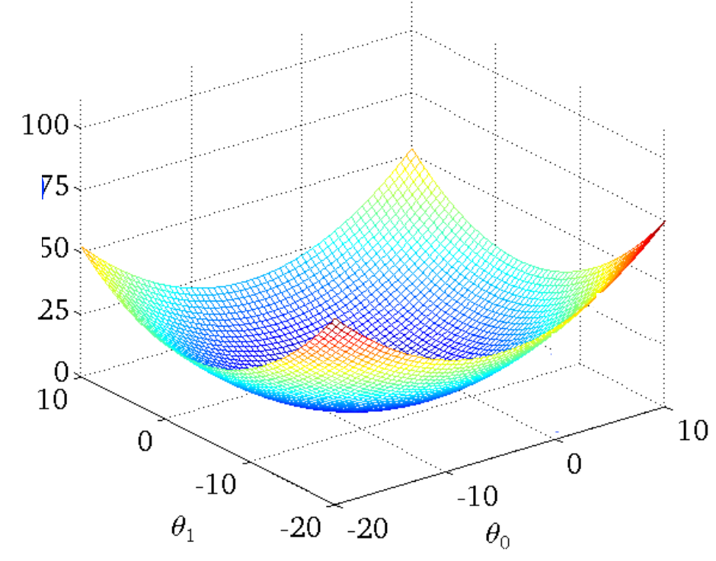
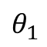
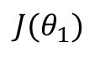
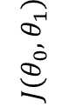
$$J(θ_{1})$$
$$J(θ_{0},θ_{1})$$
$$θ_{1}$$

Slide 16
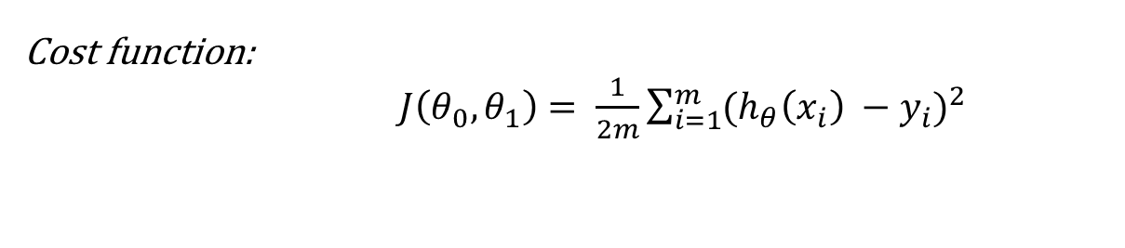
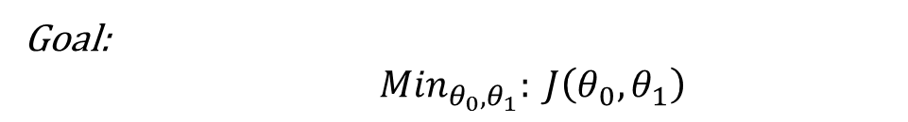
Summary
$$Hypoytesies: h_{θ}\left(x\right)= θ_{0}+ θ_{1}x$$
$Parameters: θ_{0},θ_{1}$
Cost function:
$J\left(θ_{0},θ_{1}\right)= \frac{1}{2m}\sum_{i=1}^{m}{{(h_{θ}\left(x_{i}\right) −y_{i})}^{2}}$
Goal:
${Min}_{θ_{0},θ_{1}}: J\left(θ_{0},θ_{1}\right)$

Slide 17
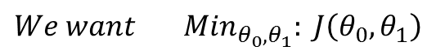
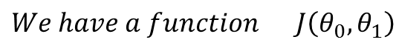
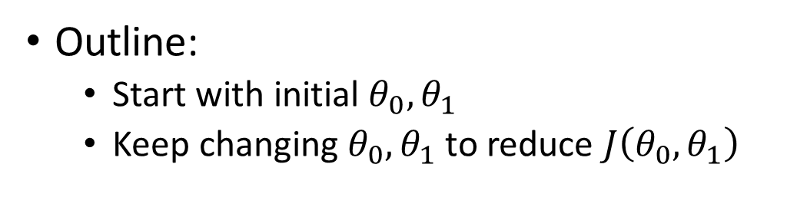
Gradient decent
We have
$$We have a function J\left(θ_{0},θ_{1}\right)$$
$$We want {Min}_{θ_{0},θ_{1}}: J\left(θ_{0},θ_{1}\right)$$
Outline:
Start with initial $θ_{0},θ_{1}$
Keep changing $θ_{0},θ_{1}$ to reduce $J\left(θ_{0},θ_{1}\right)$

Slide 18
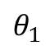
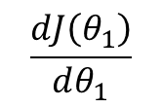
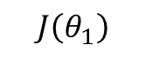
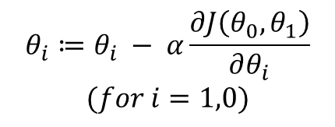
Recall form calculus
$$J\left(θ_{1}\right)$$
$$θ_{i}≔θ_{i} − α\frac{∂J\left(θ_{0},θ_{1}\right)}{∂θ_{i}}$$
$$(for i=1,0)$$
$$\frac{dJ\left(θ_{1}\right)}{dθ_{1}}$$
Negative slope
Positive slope
As we approach a local minimum, gradient descent will automatically take smaller steps. So, no need to decrease α over time.
$$θ_{1}$$
Notes:
Mention that the derivate show the direction no the value so we need the learning rate (alpha)

Slide 19
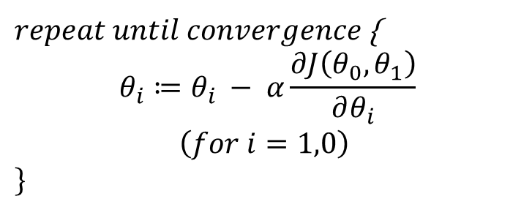
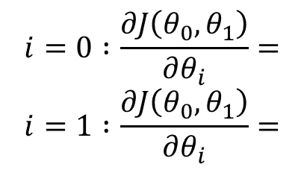
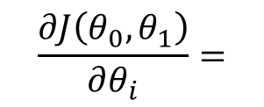
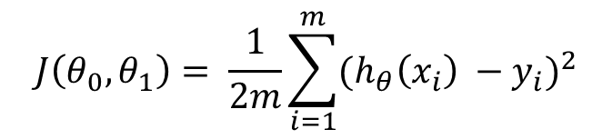
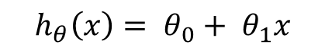
Gradient descent algorithm
Linear Regression Model
$repeat until convergence${
$$θ_{i}≔θ_{i} − α\frac{∂J\left(θ_{0},θ_{1}\right)}{∂θ_{i}}$$
$$\left(for i=1,0\right)$$
$$\}$$
$$h_{θ}\left(x\right)= θ_{0}+ θ_{1}x$$
$$J\left(θ_{0},θ_{1}\right)= \frac{1}{2m}\sum_{i=1}^{m}{{(h_{θ}\left(x_{i}\right) −y_{i})}^{2}}$$
$$\frac{∂J\left(θ_{0},θ_{1}\right)}{∂θ_{i}}=$$
$$i=0 :\frac{∂J\left(θ_{0},θ_{1}\right)}{∂θ_{i}}=$$
$$i=1 :\frac{∂J\left(θ_{0},θ_{1}\right)}{∂θ_{i}}=$$
Notes:
Solve the defrenciation

Slide 20
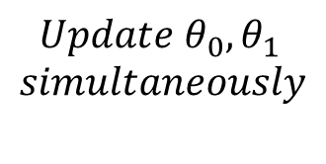
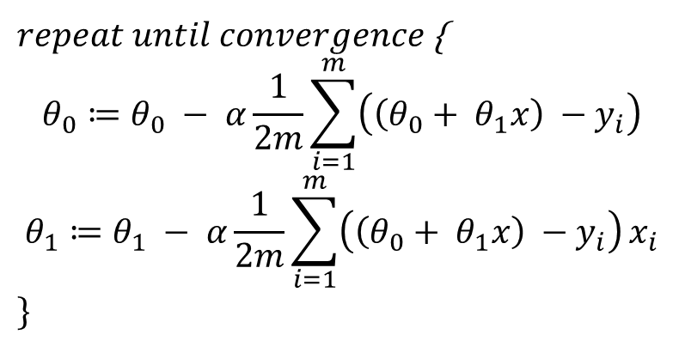
$repeat until convergence${
$$θ_{0}≔θ_{0} − α\frac{1}{2m}\sum_{i=1}^{m}{\left(\left(θ_{0}+ θ_{1}x\right) −y_{i}\right)}$$
$$θ_{1}≔θ_{1} − α\frac{1}{2m}\sum_{i=1}^{m}{\left(\left(θ_{0}+ θ_{1}x\right) −y_{i}\right)}x_{i}$$
$$\}$$
$$Update θ_{0},θ_{1}$$
$$simultaneously$$

Slide 21
If α is too small, gradient descent can be slow.
If α is too large, gradient descent can overshoot the minimum. It may fail to converge, or even diverge.
Notes:
Draw to curves to demonstrate the effect of changing the learning rate.

Slide 22
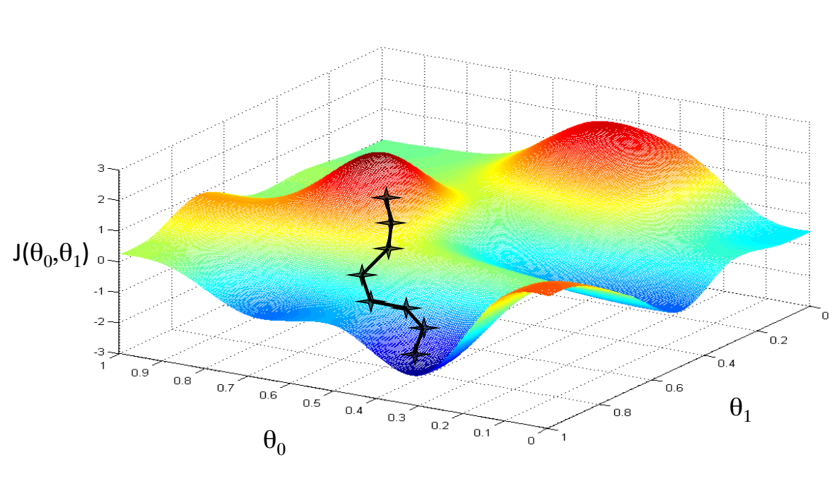
Notes:
Draw other local optimum to demonstrate that gradient decent may arrive to a local not global optimum.

Slide 23
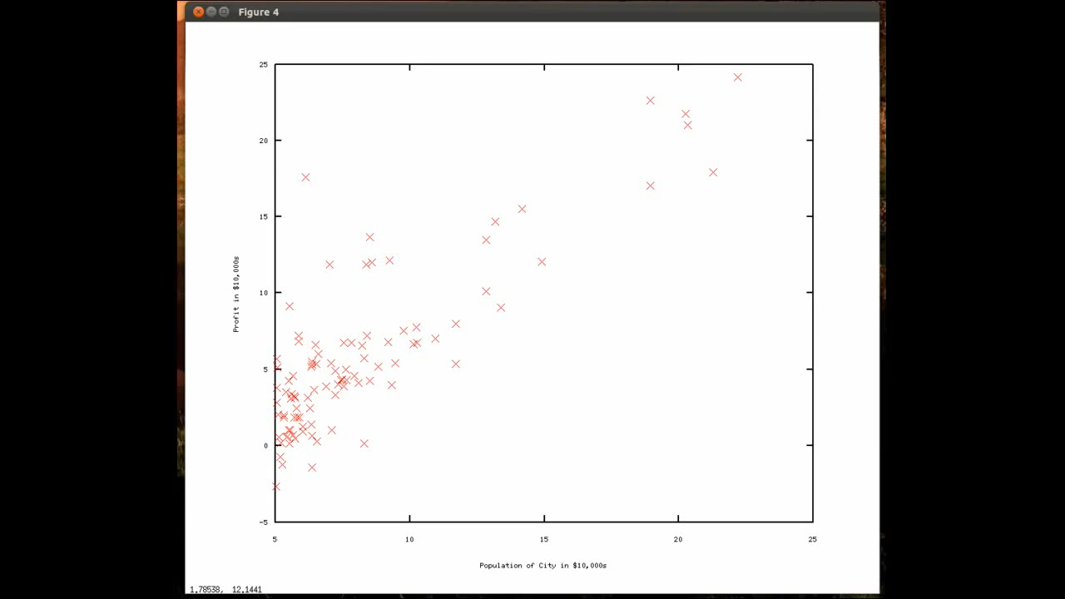

Slide 24








